Slide 1
CBETA Field maps of the FFAG magnets and beam optics results of the FFAG cell from Zgoubi
N. Tsoupas, F. Méot
Zgoubi workshop August 25 to 30 2019

Slide 2
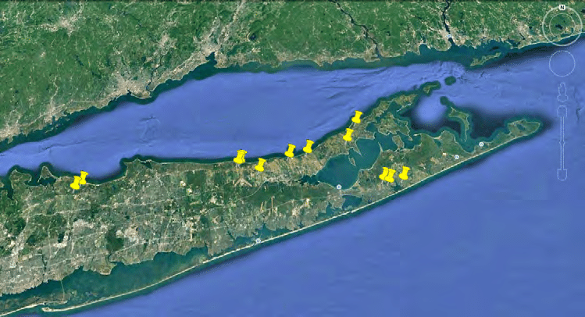
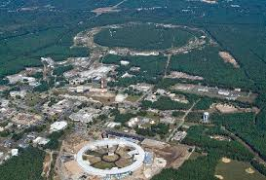

Slide 3
Outline
What the CBETA is.
What the field maps are.
Generation of field maps.
How the field maps are used.
Some results of the optical functions of CBETA as calculated by Zgoubi using field maps.

Slide 4
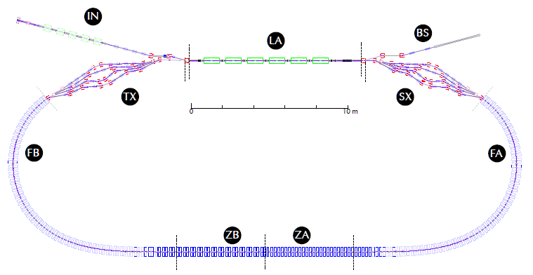
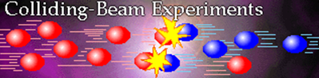
What is CBETA?
Injection: 6 MeV e⁻ 100 mA rep-rate 325 MHz
Beam dump
Merger
Splitter
1.3 GHz 16 MV/m E_{max}~80 MeV
Pass # | Energy
1 | 42
2 | 78
3 | 114
4 | 150
5 | 114
6 | 78
7 | 42
8 | 6
Two remarkable concepts:
Energy Recovery Linac (ERL)
Fixed Field Alternating Gradient (FFAG)

Slide 5
The CBETA project is a prototype for the eRHIC project
Injection: 6 MeV e⁻ 100 mA rep-rate 325 MHz
Beam dump
Merger
Splitter
1.3 GHz 16 MV/m ~80 MeV
At any given time there is an equal number of accelerating
and decelerating bunces inside the ERL.
The Power of the ERL is minimal
Pass # | Energy
1 | 42
2 | 78
3 | 114
4 | 150
5 | 114
6 | 78
7 | 42
8 | 6
Two concepts: Energy Recovery Linac (ERL)
Fixed Field Alternating Gradient (FFAG)

Slide 6
The concept of the FFAG cell
Focusing
Quad
DeFocusing
Quad
41 mm
Trajectories of e-bunches with different energy
A large energy range (42 MeV to 150 MeV) is confined in a small transverse distance of 41 mm

Slide 7
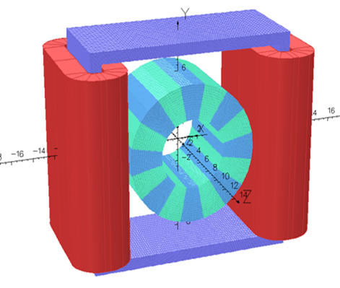
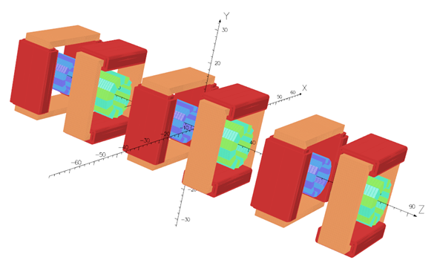
Realization of five FFAG cells on a girder
Single Halbach Magnet
with Corrector
OPERA design of 3 cells
with Correctors

Slide 8
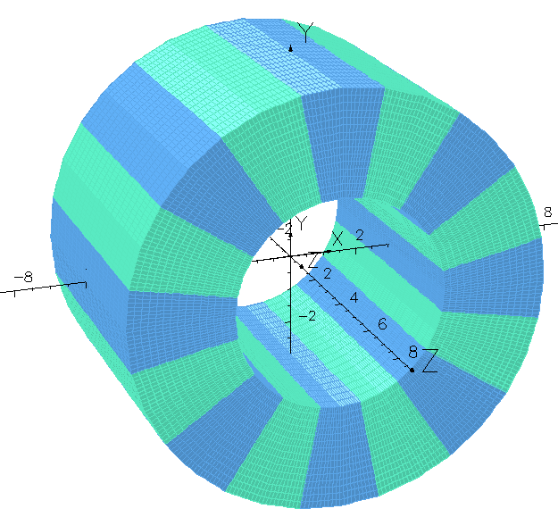
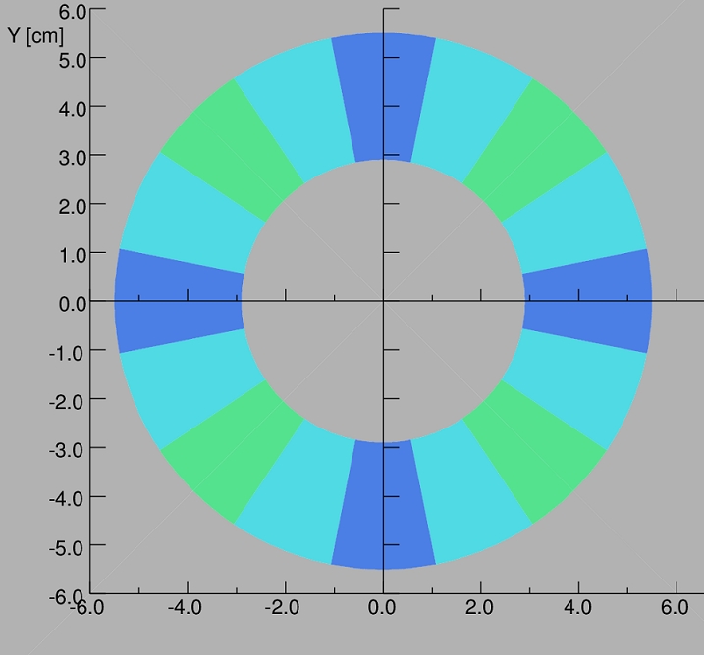
The Halbach Quadrupole
θ
α
Perspective view of Magnetized Wedges
Dipole n=1
Quad n=2
Sext n=3
Direction of the easy axis α=(n+1)θ +π/2
Cross section of Magnetized Wedges of NdFeB or SmCo

Slide 9
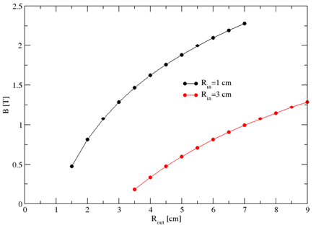
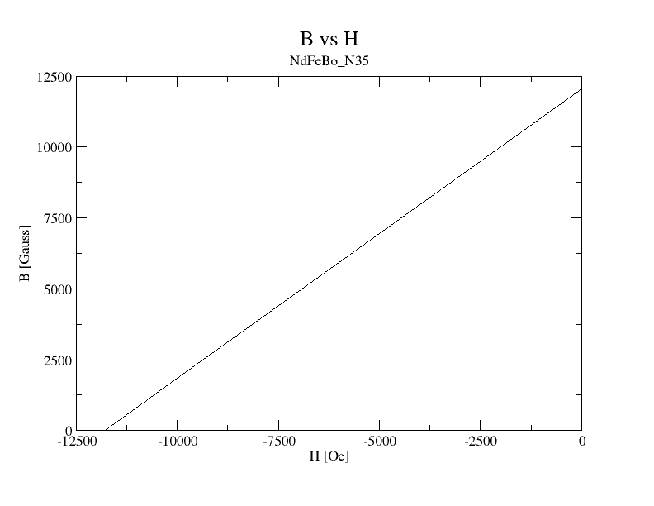
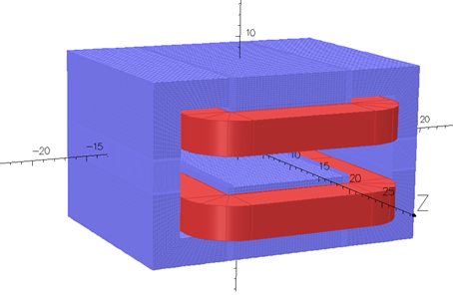
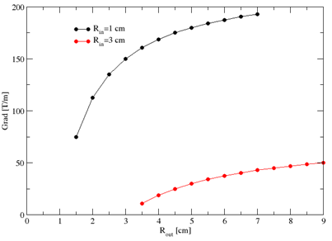
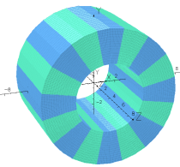
Large fields in small volume magnet
r_{out}
r_{i}
Gap=3 cm W=30 cm H=18 cm B_{max}~ 1 Tesla
Needs Power Supply and water for cooling

Slide 10
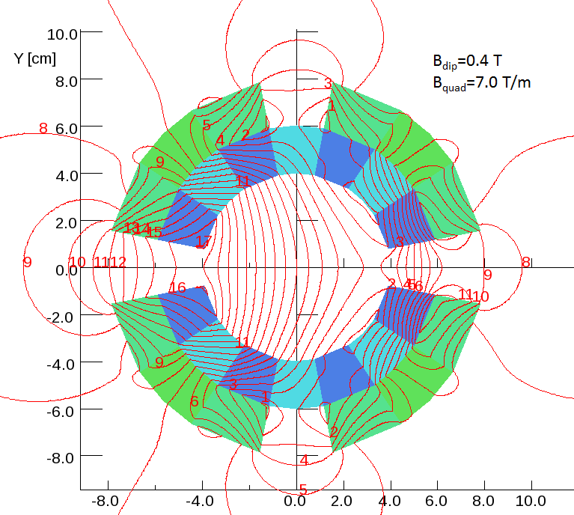
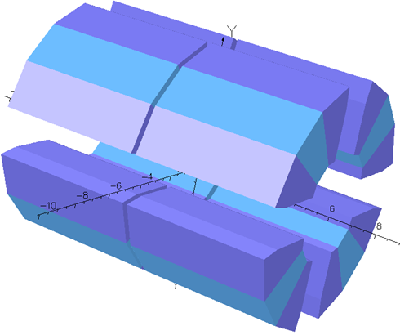
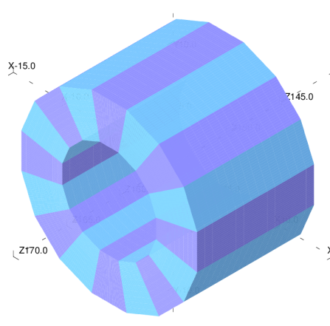
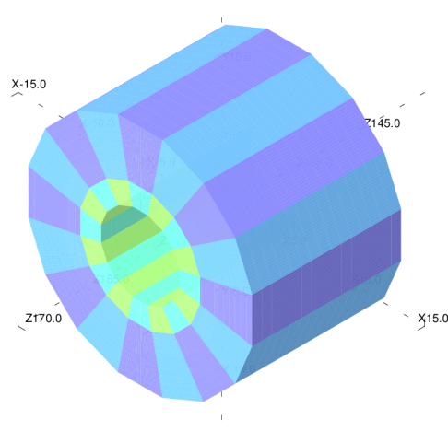
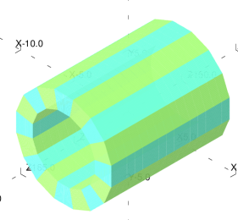
Halbach Magnets do not interfere NO-Cross-talk
Permanent magnet material is saturated (μ∼1)
The field of one magnets will add to that of the other
+
Halbach Dipole
Halbach Quadrupole
Dipole, Quadrupole combination

Slide 11
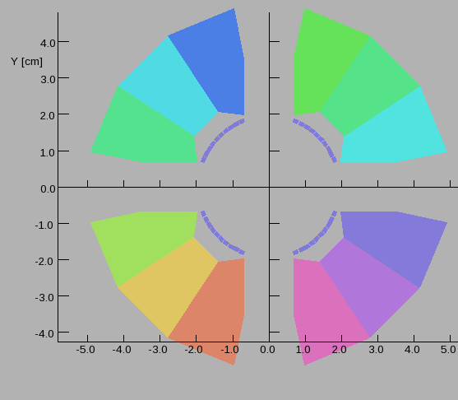
Wire-Correction of harmonics

Slide 12
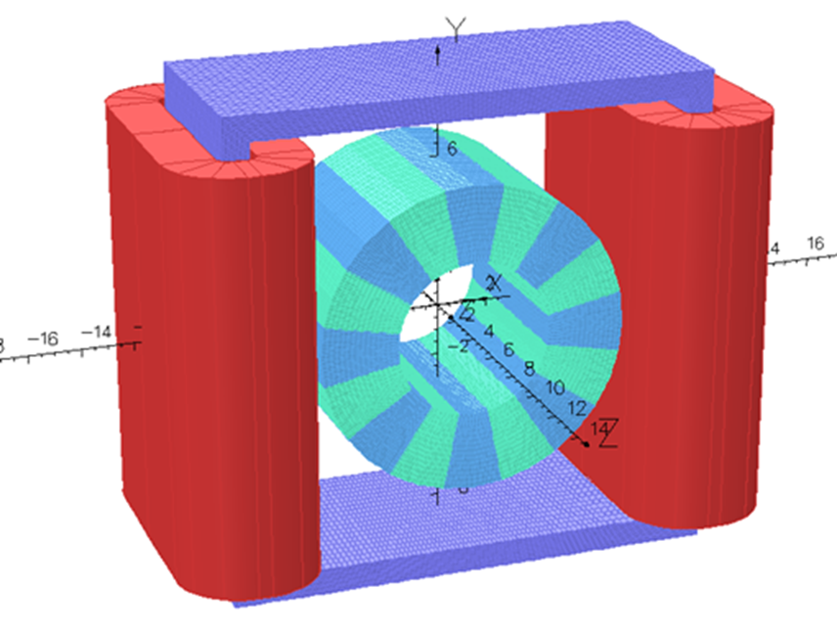
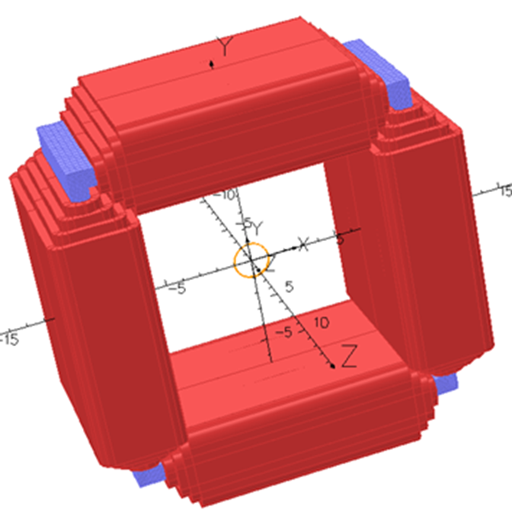
Correctors

Slide 13
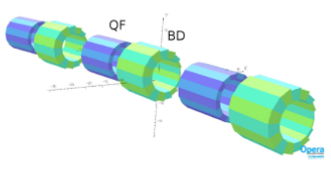

Slide 18
Thank you for your attention

Slide 19
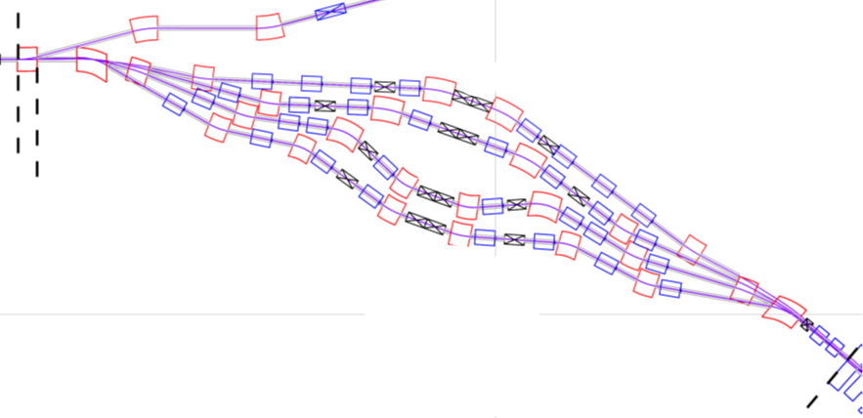



The splitter of the CBETA accelerator
Beam Dump Line
150 MeV
114 Mev
78 MeV
42 MeV
S4.BEN01
ERL
S1.BEN01
S2.BEN01
FFAG

Slide 20
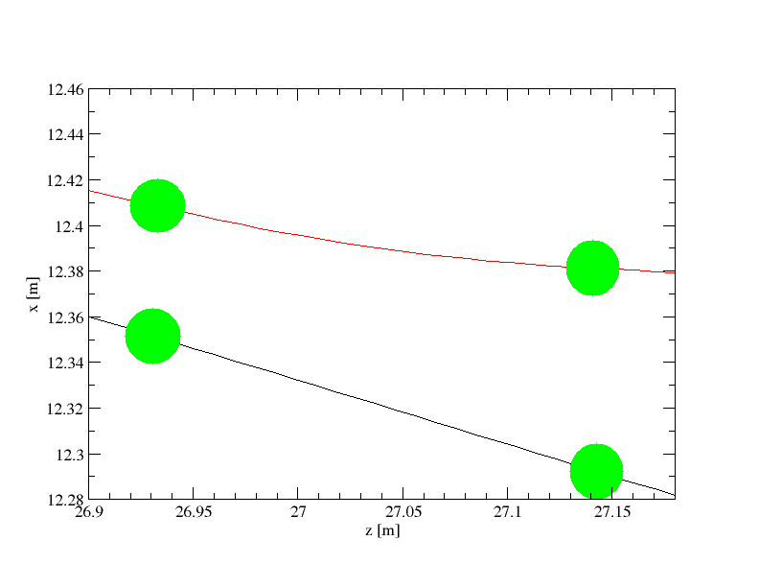
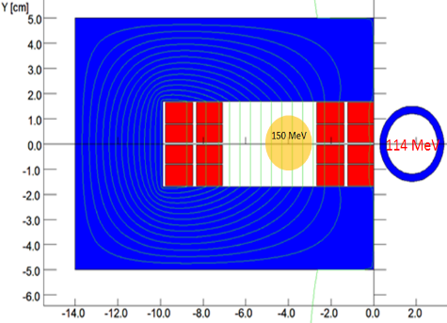
The trajectories of the 114 MeV and 150 MeV beams at the location of the
S4.BEN01 dipole magnet.
Iron
Coil
Trajectory of 150 MeV
Walls of vacuum chamber for 150 MeV
Magnet cross section Normal
to the beam direction
Magnet cross section along the
median plane to the magnet
Coil
Trajectory of 114 MeV
Vacuum pipe for 114 MeV

Slide 21

ΔB/B~5x10⁻⁴
B<9 mGauss

Slide 22
Why do we propose an alterative magnet?
Table A2. S4.BEN01 Magnet specifications
Length [m] | B_{field} [T] | Bend angle | Sagitta [cm] | Gap [cm] | Septum [cm] | Hor. Aper. [cm] | Current [A.turns] | J [A/cm²]
0.2 | 0.40617 | 9.3º | 0.2 | 3.4 | 2.68 | 3.5 | 10990 | 1400
This magnet with the power supply will cost more than $150K

Slide 23
The Halbach magnet
The Halbach type Magnet
Cross section of Magnetized Wedges of NdFeB or SmCo
θ
α
Isometric view of Magnetized Wedges
Dipole n=1
Quad n=2
Sext n=3
Direction of the easy axis α=(n+1)θ +π/2
α=direction of the easy axis
θ=azimuthal angle of the wedge

Slide 24

Dipole field
r_{out}
r_{i}
Quadrupole field n=2
Gap=3 cm W=30 cm H=18 cm B_{max}~ 1 Tesla
Electromagnet Needs High current Supply

Slide 25
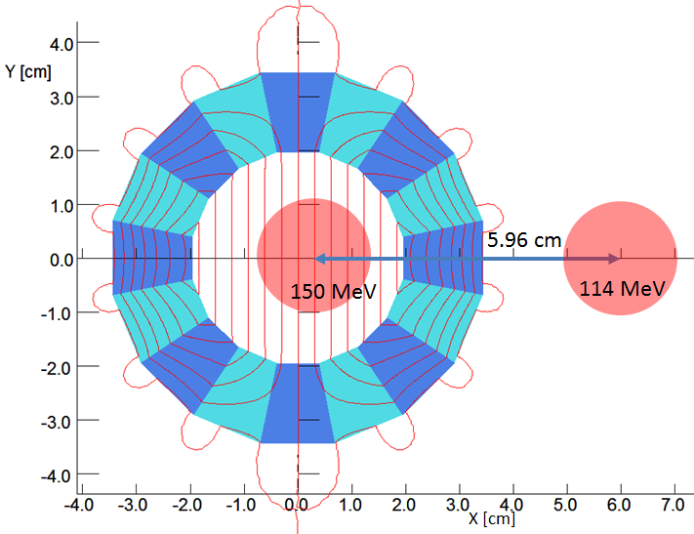
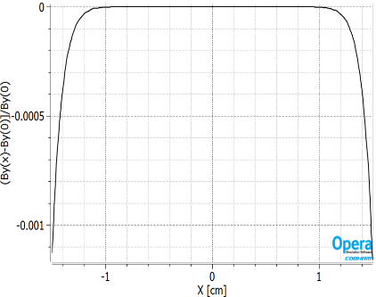
Field Uniformity of Halbach magnet (2D)
ΔB/B~5x10⁻⁴

Slide 26
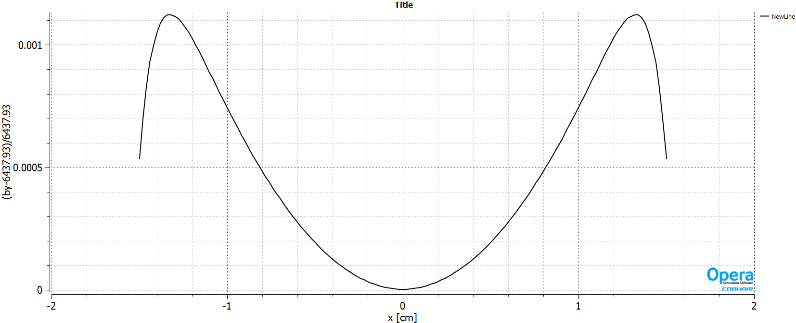
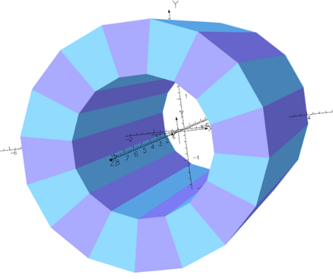
Field Uniformity of Halbach magnet (3D)
Table 3. The S4.BEN01 modified Halbach-type magnet specifications
Length [m] | B_{field} [T] | Sagitta [cm] | R_{in} [cm] | R_{in} [cm] | PM Material | B_{r} [T] | H_{c} [A/m]
0.12 | 0.30 | 0.12 | 2.0 | 3.5 | NdFeB_N35EH | 1.2040 | -147.03

Slide 27
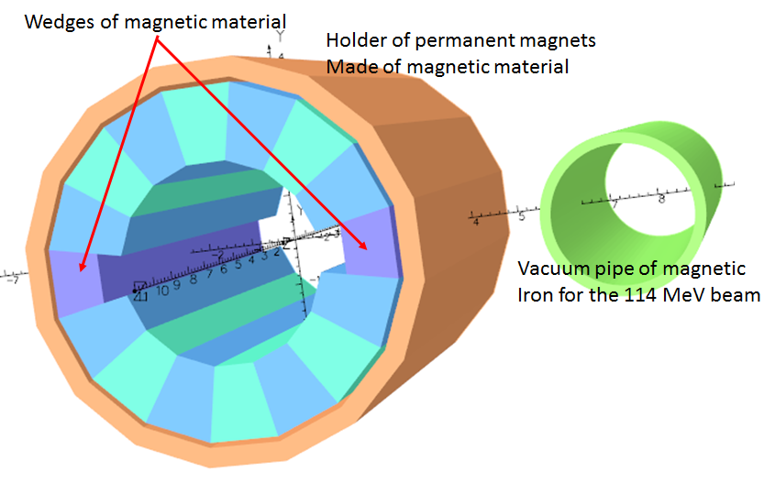
Modified Halbach magnet to reduce radiation damage

Slide 28
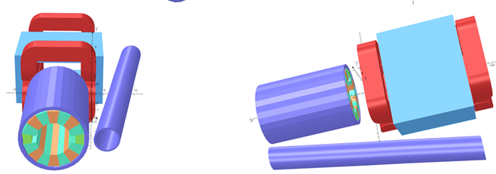
Isometric views of the Halbach magnet followed by a low field corrector electromagnet
Low field
corrector magnet
Vacuum pipe of
magnetized material
150 MeV
114 MeV

Slide 29
Conclusions Halbach vs electromagnet
The Halbach magnet occupies smaller volume and can generates higher field in the same aperture.
It costs much less then the electromagnet.
It can be temperature controlled by water cooling.
It is subject to radiation damage.
This is not a serious problem in the environment of 150 MeV electrons.
The magnet will also be shielded for radiation damage.

Slide 30
Thank you for your attention

